Slide 1
Java programming #4 Date&Time
Dmitry Chub
Telegram: @dmchub

Slide 2
Date and time overview
java.time — Base package of Date Time API. All the classes are thread safe and immutable
java.time.chrono — Generic API for calendar systems other than the default ISO
java.time.format — Parse and format date classes
java.time.zone — Classes that support different time zones
full documentation

Slide 3
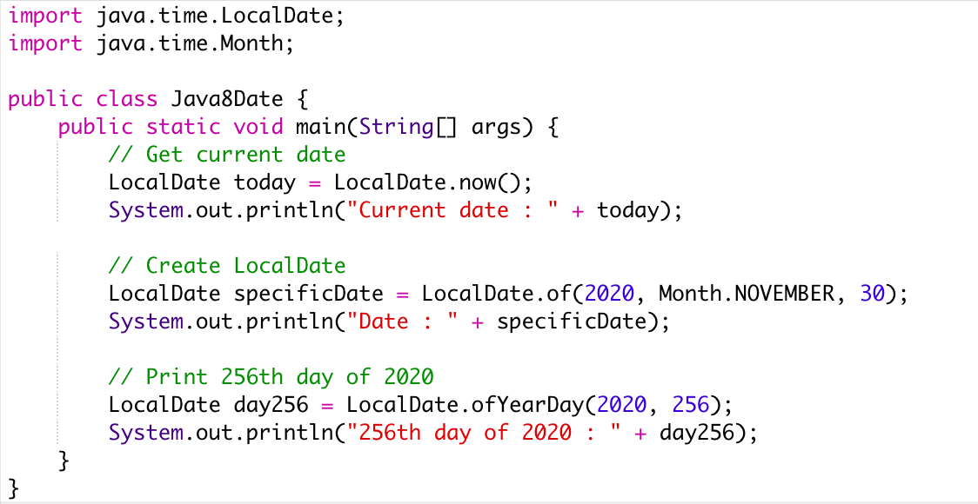
Date example

Slide 4
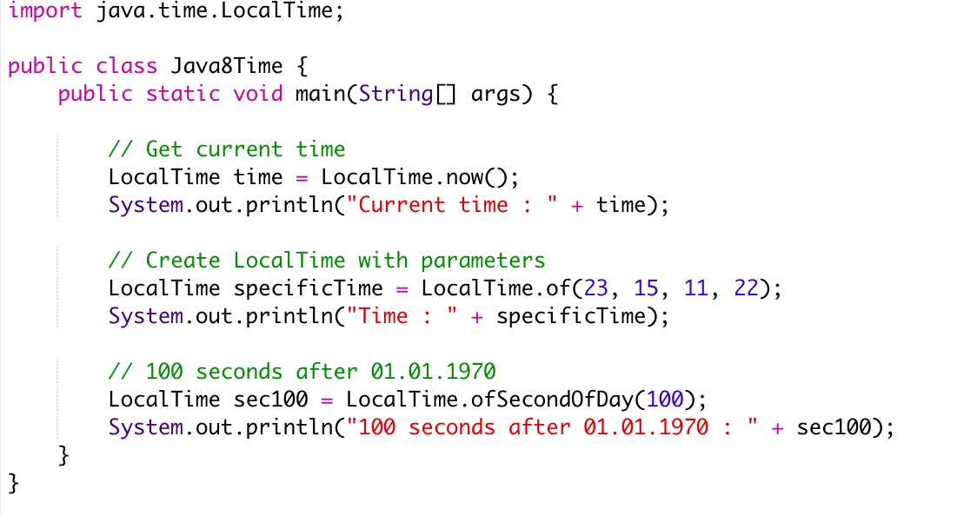
Time example

Slide 5
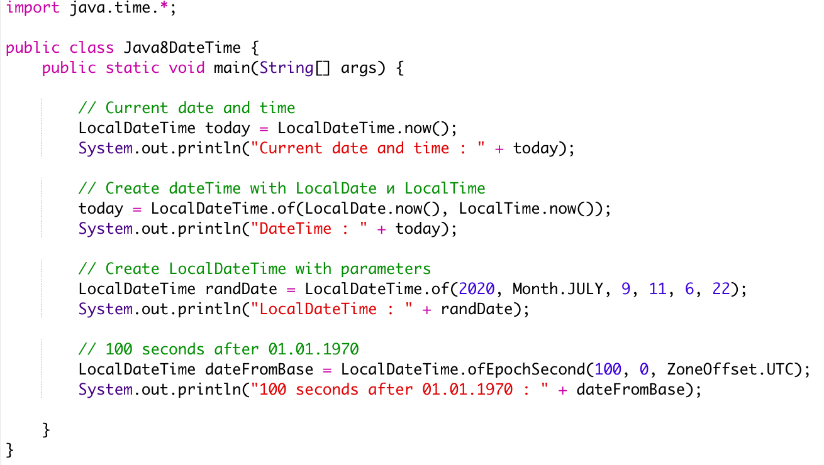
DateTime example

Slide 6
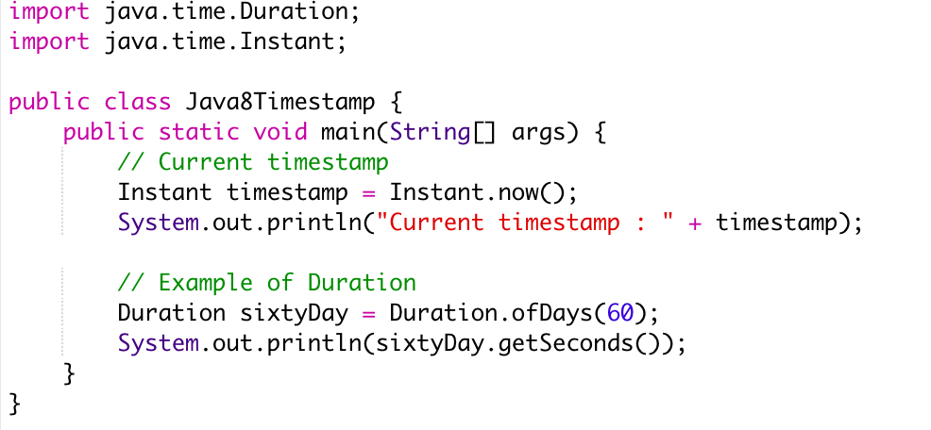
Periods of time example

Slide 7
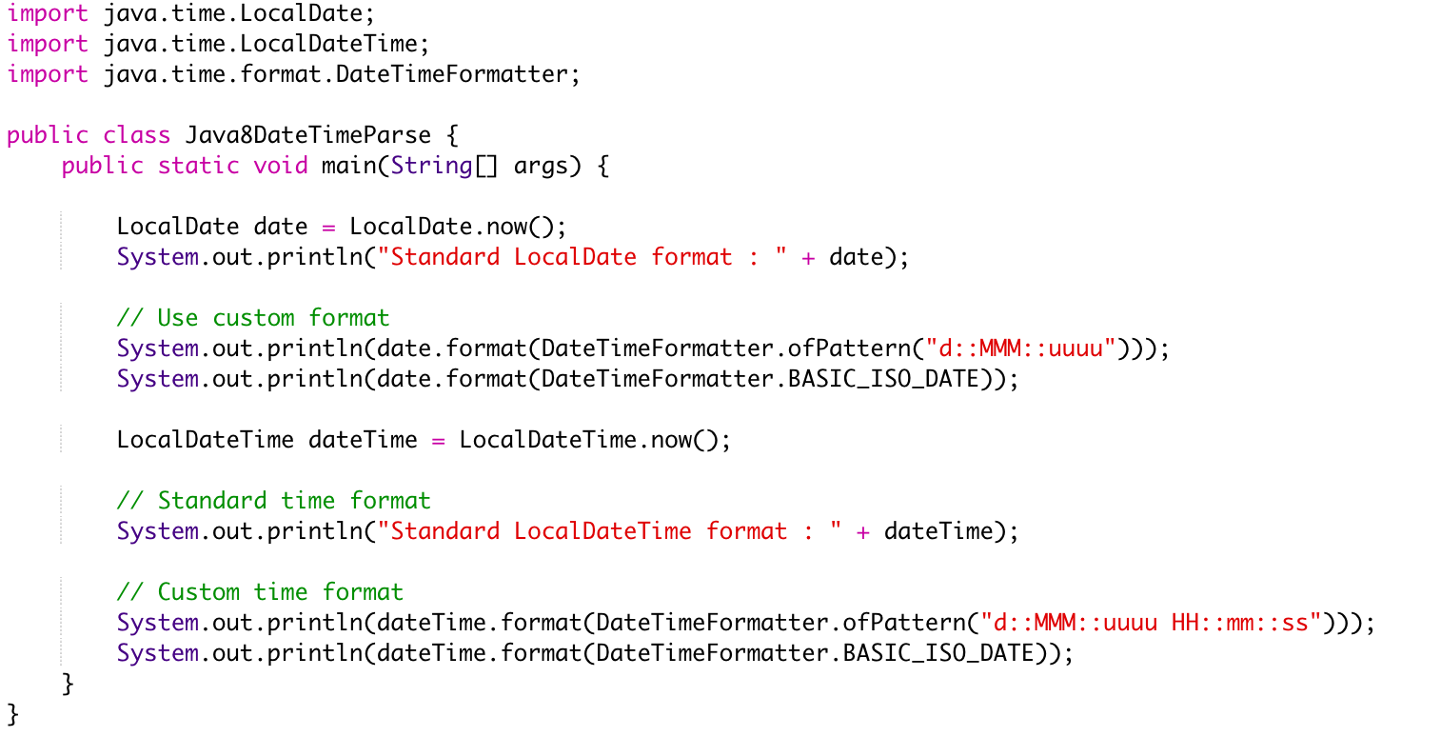
Date and time format example

Slide 8
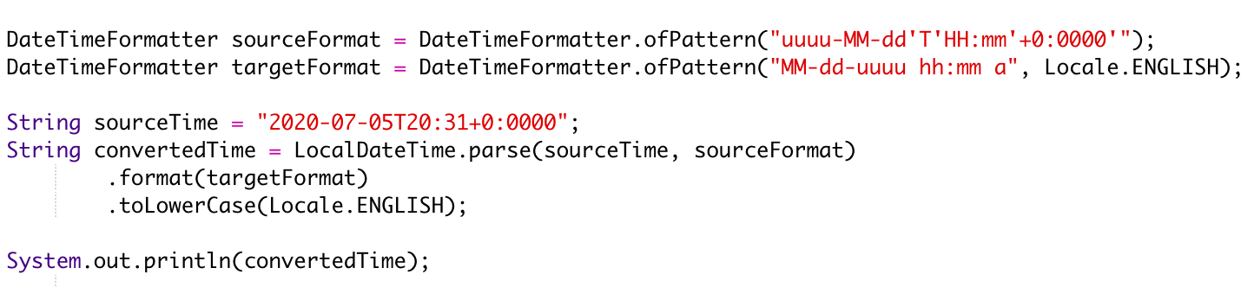
Parse date with formatter

